Slide 1

datacenter meetup – April 2019 #SCUGno

Slide 2
Backing up your enterprise with Data Protection Manager
Jan Egil Ring
Lead Architect, Crayon

Slide 3
DPM Basics
Agenter installeres på servere/klienter
Volume Shadow Copy (VSS) benyttes for å ta et point in time snapshot av filsystem
Application aware ift Exchange, Sharepoint og SQL
Short term backup: Backup til disk med retention på inntil 64 recovery points.
Long term backup: Backup til tape eller sky med retention tid på inntil 99 år. Virtuelle tape-bibliotek som for eksempel EMC DataDomain og Firestreamer kan også benyttes.

Slide 4

Continuous backup and protection
System Center Operations Manager
Active Directory Hyper-V File Services
Disk-based recovery
Azure Backup
Up to every 15 minutes
System Center Data Protection Manager
Windows Client
Data protection manager disaster recovery (with offsite replication and tape)
Tape-based backup
Notes:
https://www.google.no/url?sa=t&rct=j&q=&esrc=s&source=web&cd=2&ved=0ahUKEwichOSol5TPAhXNbZoKHdTtDaoQFggkMAE&url=http%3A%2F%2Fdownload.microsoft.com%2Fdownload%2FF%2FA%2FF%2FFAF71404-CBBE-4428-A9ED-43D690F8E9BE%2FMoznosti_zalohovani_infrastruktury_Microsoft_Jan_Matejka_Mainstream.pptx&usg=AFQjCNGNuPp5lblcF39a-2SeMsvTfQjdDw&bvm=bv.133053837,d.bGs

Slide 5
Demo
DPM Basics

Slide 6
DPM deployment considerations
As a physical standalone server
As a Hyper-V virtual machine
As a Windows virtual machine in VMWare
As an Azure virtual machine
Notes:
In all deployments you’ll need:
A SQL Server instance, installed and running, to use for the DPM database. The instance can be collocated on the DPM server or remote.
Disk to be used as dedicated space for DPM data storage.
DPM protection agent installed on computers and servers you want to protect using DPM.
https://docs.microsoft.com/en-us/system-center/dpm/prepare-environment-for-dpm?view=sc-dpm-1807
Disk for storage pool 1.5 times the size of the protected data
Recommended: 2-3 times the size of the protected data
Modern Backup Storage Use Volumes.
A single DPM server has a soft limit of 120 TB storage.

Slide 7

DPM Storage
DPM OS (whether virtual or physical) needs local storage
Leverages Storage Spaces in DPM 2016 and later
DPM can leverage Storage Spaces for both DPM storage and the underlying VHDX-files
Several ways to use Storage Spaces:
On a stand-alone server with all storage in a single server
On a clustered server using Storage Spaces Direct with local, direct-attached storage in each cluster node
On a clustered server with one or more shared SAS storage enclosures holding all drives
Notes:
All of the ways to leverage Storage Spaces can be used for a physical Hyper-V host hosting virtual DPM servers
A DPM server, virtual or physical will leverage Storage Spaces when using Modern DPM Storage which we`ll cover next

Slide 8
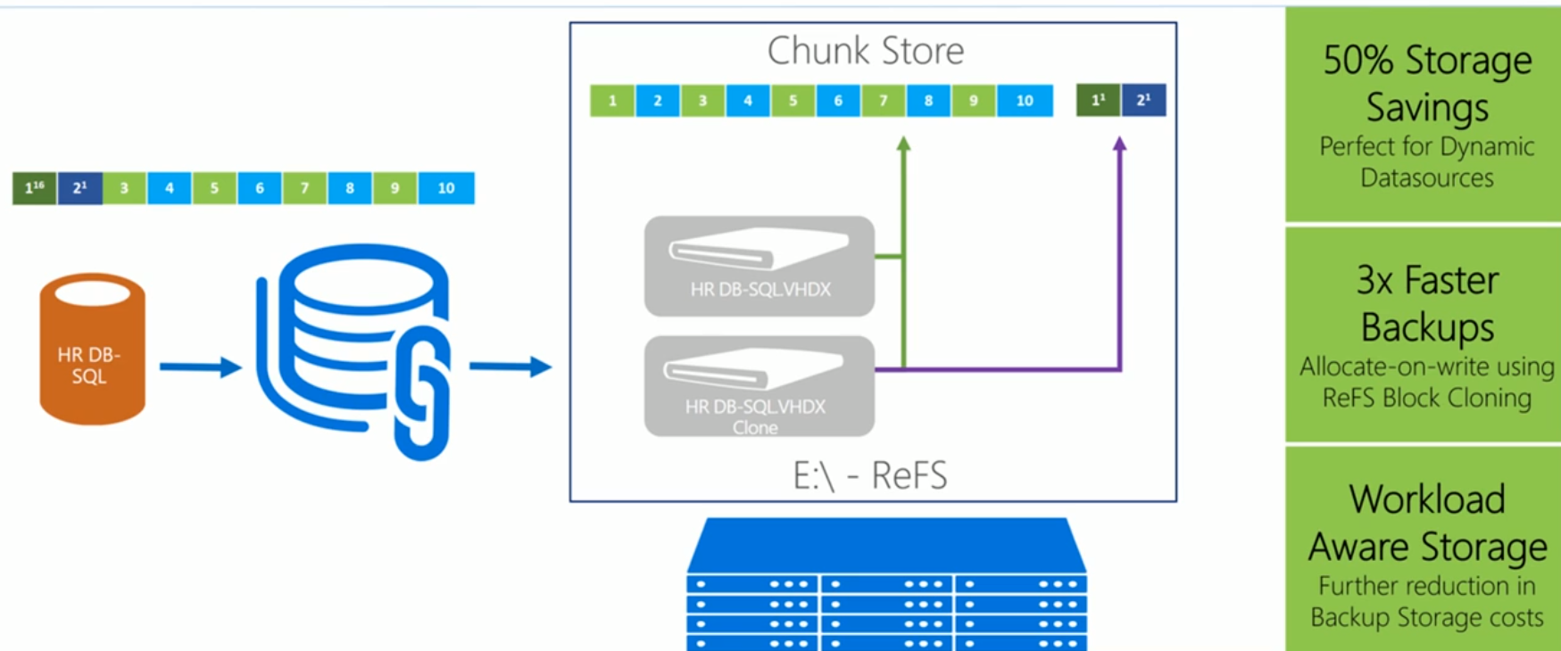
Modern DPM Storage
Notes:
Storage Spaces is a technology in Windows and Windows Server that can help protect your data from drive failures. It is conceptually similar to RAID, implemented in software. You can use Storage Spaces to group three or more drives together into a storage pool and then use capacity from that pool to create Storage Spaces. These typically store extra copies of your data so if one of your drives fails, you still have an intact copy of your data. If you run low on capacity, just add more drives to the storage pool.
The Resilient File System (ReFS) is Microsoft's newest file system, designed to maximize data availability, scale efficiently to large data sets across diverse workloads, and provide data integrity by means of resiliency to corruption. It seeks to address an expanding set of storage scenarios and establish a foundation for future innovations.
Accelerated VM operations - ReFS introduces new functionality specifically targeted to improve the performance of virtualized workloads:
Block cloning - Block cloning accelerates copy operations, enabling quick, low-impact VM checkpoint merge operations.
Sparse VDL - Sparse VDL allows ReFS to zero files rapidly, reducing the time needed to create fixed VHDs from 10s of minutes to mere seconds.
Integrity-streams - ReFS uses checksums for metadata and optionally for file data, giving ReFS the ability to reliably detect corruptions.
Storage Spaces integration - When used in conjunction with a mirror or parity space, ReFS can automatically repair detected corruptions using the alternate copy of the data provided by Storage Spaces. Repair processes are both localized to the area of corruption and performed online, requiring no volume downtime.
Salvaging data - If a volume becomes corrupted and an alternate copy of the corrupted data doesn't exist, ReFS removes the corrupt data from the namespace. ReFS keeps the volume online while it handles most non-correctable corruptions, but there are rare cases that require ReFS to take the volume offline.
Proactive error correction - In addition to validating data before reads and writes, ReFS introduces a data integrity scanner, known as a scrubber. This scrubber periodically scans the volume, identifying latent corruptions and proactively triggering a repair of corrupt data.
In addition to providing resiliency improvements, ReFS introduces new features for performance-sensitive and virtualized workloads. Real-time tier optimization, block cloning, and sparse VDL are good examples of the evolving capabilities of ReFS, which are designed to support dynamic and diverse workloads
https://docs.microsoft.com/en-us/windows-server/storage/refs/refs-overview

Slide 9
Deduplicate DPM Storage
Recommended topology:
DPM running in a virtual machine in a Hyper-V host cluster.
DPM storage using VHD/VHDX files stored on an SMB 3.0 share on a file server.
Notes:
https://docs.microsoft.com/en-us/system-center/dpm/deduplicate-dpm-storage
Leverages deduplication on the host
This deployment is supported for DPM 2012 R2, and for all workload data that can be backed up by DPM 2012 R2.
All the Windows File Server nodes on which DPM virtual hard disks reside and on which dedup will be enabled must be running Windows Server 2012 R2 with at least Update Rollup November 2014.

Slide 10
Demo
DPM storage
Notes:
Host storage
Modern DPM storage inside DPM VM

Slide 11
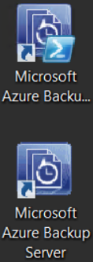
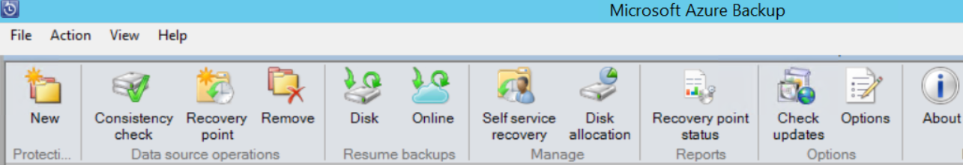
Azure Backup Server
Annonsert høsten 2015
DPM uten støtte for tape
Ingen System Center-integrasjon eller lisensiering
Gratis for Azure Backup-kunder
https://azure.microsoft.com/nb-no/blog/announcing-microsoft-azure-backup-server

Slide 12
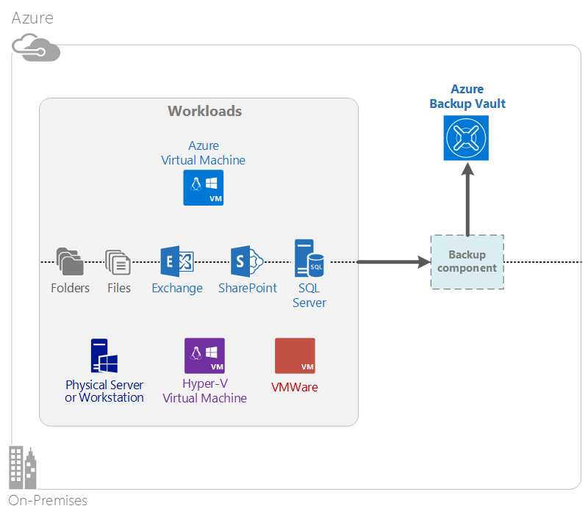
Azure Backup
Unlimited scaling
Unlimited data transfer
Data encryption
Long term retention (9999 RPs)
Notes:
https://docs.microsoft.com/en-us/azure/backup/backup-introduction-to-azure-backup#which-azure-backup-components-should-i-use

Slide 13
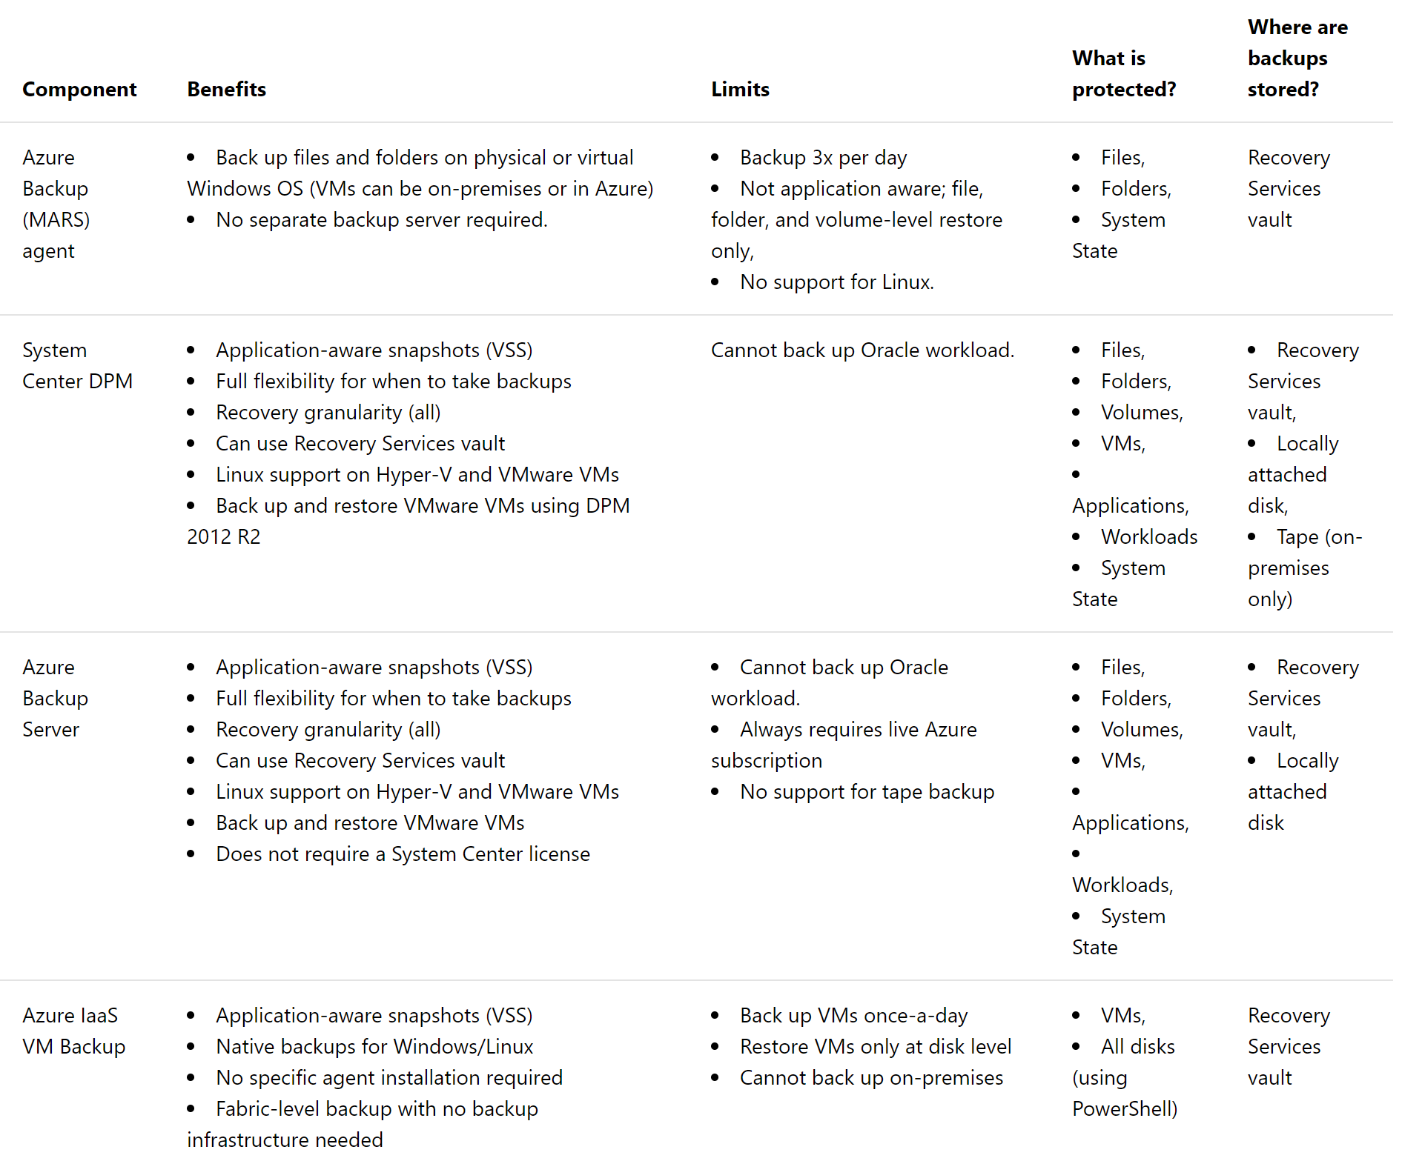
Which Azure Backup components should I use?

Slide 14
Demo
Azure Backup integration

Slide 15
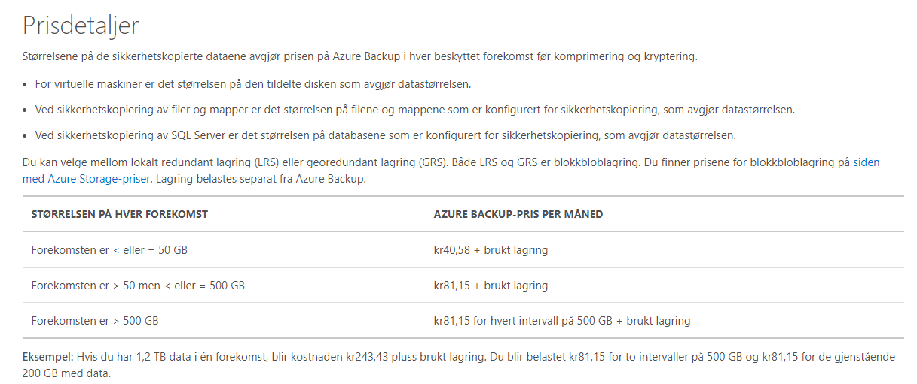

Slide 16
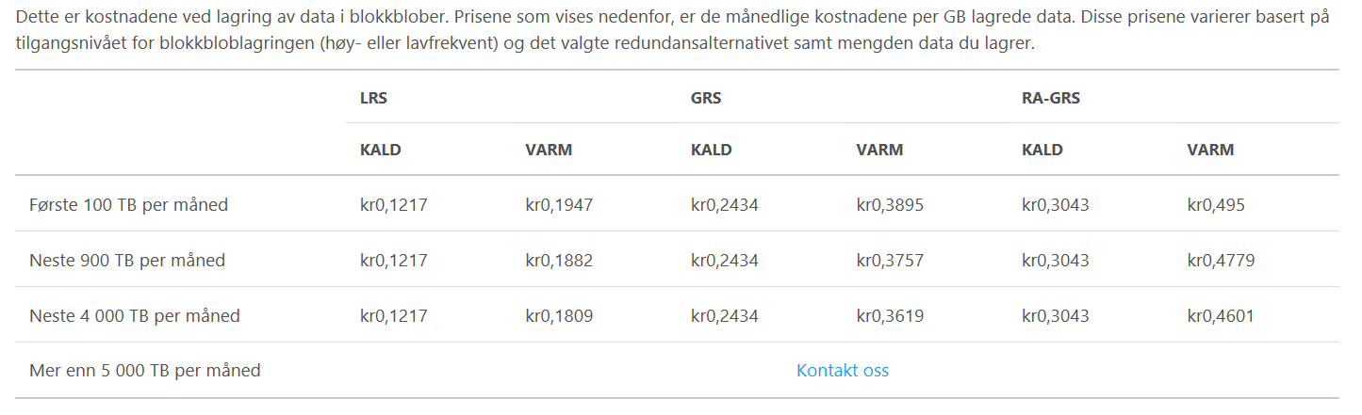
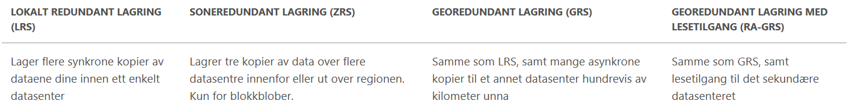

Slide 17
Tools for estimating costs
PowerShell Script
https://gallery.technet.microsoft.com/Estimating-Azure-Backup-e0d4abbc
The script collects information from the DPM database on the datasource sizes, machines, and recovery points. This information is processed, aggregated, and presented as an HTML output file.
Use the TCO calculator excel sheet
https://gallery.technet.microsoft.com/Azure-Backup-Monthly-bill-093fd095
An excel sheet to simplify the work of estimating the actual Azure bill.

Slide 18
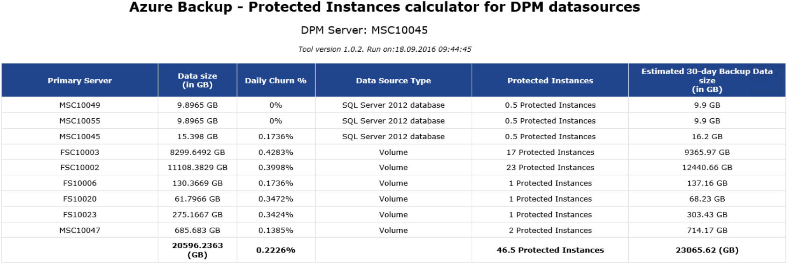
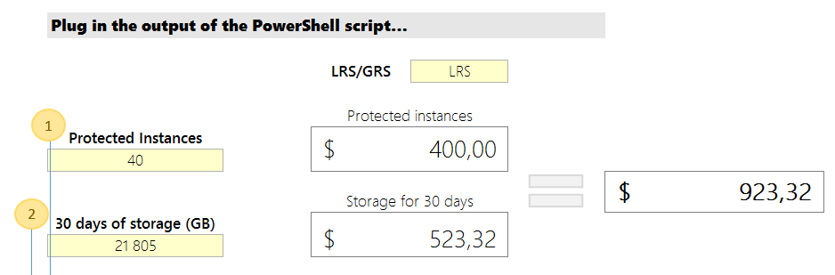

Slide 19
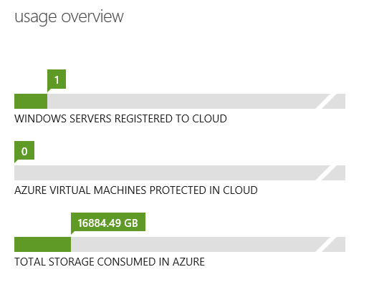
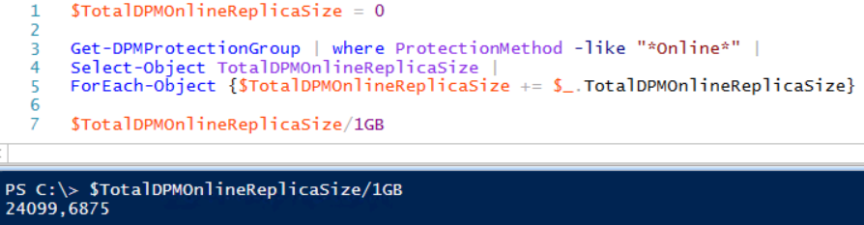
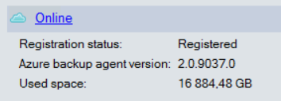

Example – Norwegian customer
LRS
File-cluster – ca 19 TB
40 «protected instances»
Ca 30% compresstion
Costs: ca 3 500 ,- NOK per month

Slide 20
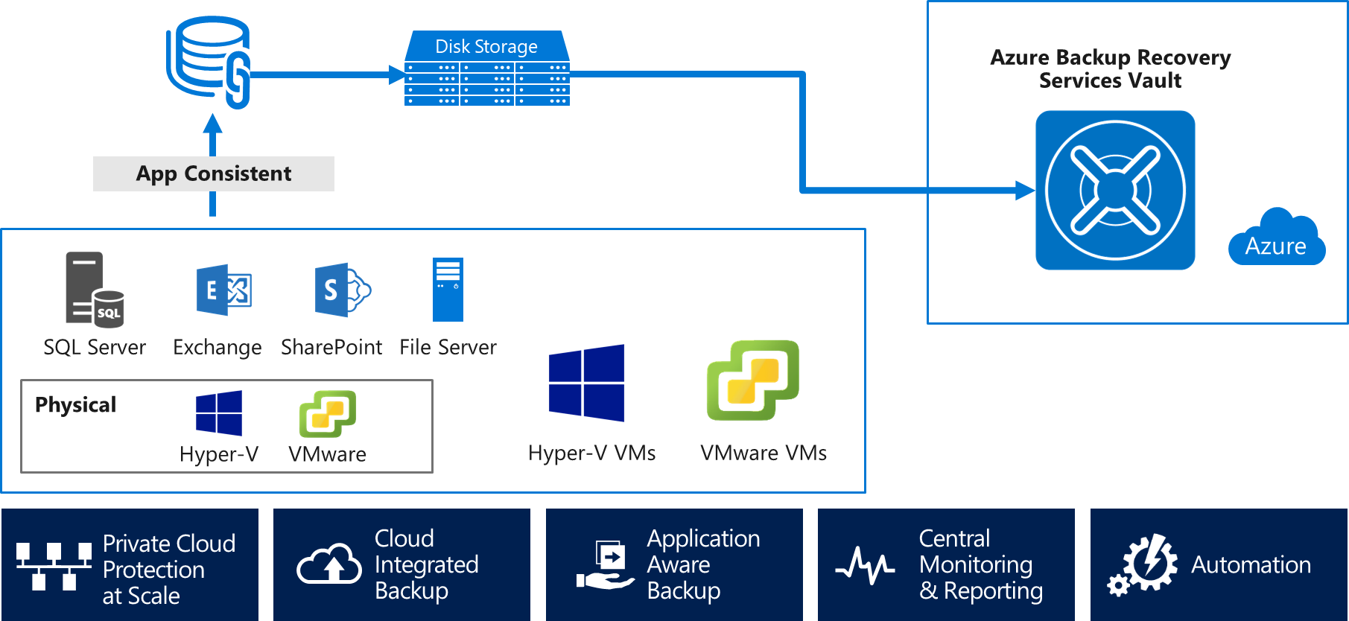



DPM 2019
Support Windows Server 2019, SQL Server 2017
VMware to tape backup
Modern backup storage improvements
Greater flexibility in recovering from Azure

Slide 21


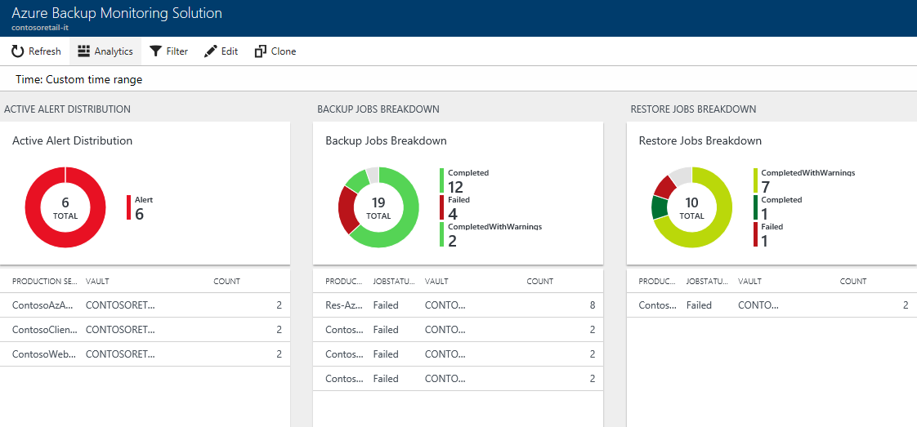
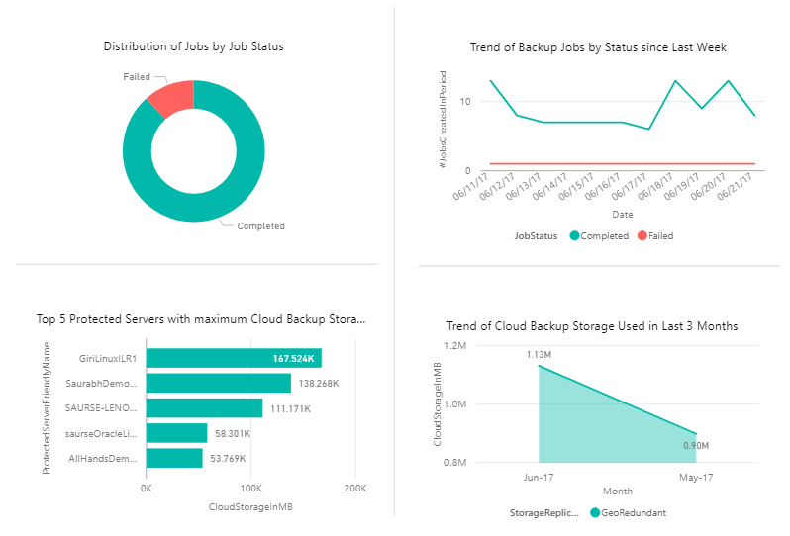
Rich Reporting and Monitoring
Log Analytics
Custom Queries
ITSM Integration
Azure Backup
No infrastructure
System Center DPM
Enterprise Wide
Power BI
Custom Reports
Azure Storage
Microsoft
Azure Backup Server
Cross tenant support

Slide 22
Demo
Azure Backup reporting

Slide 23
Resources
DPM Product documentation
https://docs.microsoft.com/en-us/system-center/dpm
Azure Backup
https://docs.microsoft.com/en-us/azure/backup/backup-introduction-to-azure-backup
Data Protection Manager Community Extensions PowerShell module
http://www.powershell.no/backup/2017/07/03/introducing-dpm-cx.html

Slide 24
Resources
Azure Backup monitoring and dashboard
https://docs.microsoft.com/en-us/system-center/dpm/monitor-dpm?view=sc-dpm-2019#monitor-dpm-in-the-azure-console
https://azure.microsoft.com/en-gb/resources/templates/101-backup-oms-monitoring/
https://azure.microsoft.com/en-us/blog/oms-monitoring-solution-for-azure-backup-using-azure-log-analytics/

Slide 25
Bonus demo!
Data Protection Manager Community Extensions PowerShell module
Notes:
http://www.powershell.no/backup/2017/07/03/introducing-dpm-cx.html

Slide 26


Want future Updates?
Like | & | Follow us!
@SCUGNorway
www.facebook.com/SCUGNorway

Slide 27


Let’s get Social and Share!
#SCUGno
#SCUGno
#SCUGno
#SCUGno

Slide 28

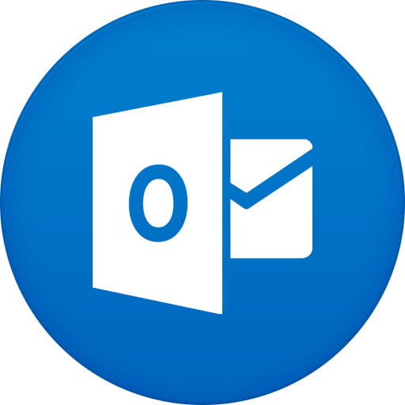
Get in touch with us
www.scug.no
info@scug.no

Slide 29
Sharing is Everything

